Slide 1
SOFTWARE PROCESS MODELS
Mehwish Mumtaz

Slide 2
What Do We Mean by a Process?
Is a series of steps involving activities, constraints, and resources to produce an intended output
Prepare for exams
Conduct a software competition
Organize a trip
Write a term project report
Involves a set of tools and techniques
Block diagrams
Notations

Slide 3
How is a Process Useful?
Impose consistency and structure on a set of activities
Guide us to understand, control, examine, and improve the activities
Enable us to capture our experiences and pass them along

Slide 4
Characteristics of a Process
Prescribes all major process activities
Uses resources, subject to set of constraints (such as schedule)
Produces intermediate and final products
May be composed of sub-processes with hierarchy or links
Each process activity has entry and exit criteria
Activities are organized in sequence, so timing is clear
Each process guiding principles, including goals of each activity
Constraints may apply to an activity, resource or product

Slide 5
Software Lifecycle
When a process involves building a software (product), the process may be referred to as software (product) lifecycle
Requirements analysis and definition
System (architecture) design
Program (detailed/procedural) design
Writing programs (coding/implementation)
Testing: unit, integration, system
System delivery (deployment)
Maintenance

Slide 6
What is a Process Model?
Description of a process, evolved overtime, in a certain format
May use text, pictures, or a combination
Contains key process features

Slide 7
Why is a Process Model Needed?
To form a common understanding
To find inconsistencies, redundancies, omissions
To find and evaluate appropriate activities for reaching process goals
To tailor a general process for a particular situation in which it will be used

Slide 8
Nature of Software Process Model?
Models that prescribe how should development of software progress
Models that describe how is software developed in actuality

Slide 9
Framework Activities
Communication
customer, other stakeholders
Planning
Roadmap, project plan
Modeling
Understanding requirements, provide design
Construction
Code generation, testing
Deployment
Delivery to customer, feedback and evaluation

Slide 10
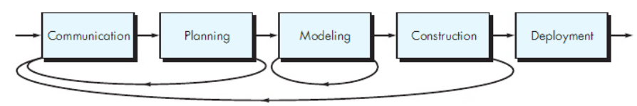
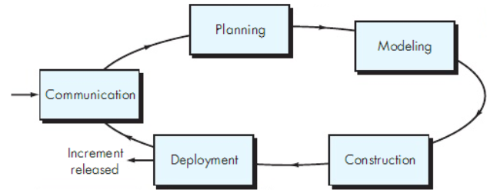
Process Flow

Slide 11
Software Development Process Models
Waterfall model
Classical
With prototyping
V model
Prototyping model
Phased development: increments and iterations
Spiral model
Unified process
Rapid Application Development (RAD)
Agile methods
XP
Scrum
Kanban

Slide 12
Waterfall Model
One of the first process development models proposed
Works for well understood problems with minimal or no changes in the requirements
Simple and easy to explain to customers
It presents
a very high-level view of the development process
sequence of process activities
Each major phase is marked by milestones and deliverables (artefacts)

Slide 13
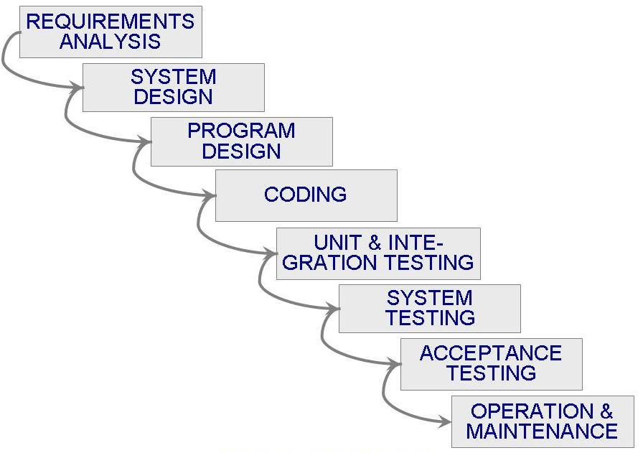
Waterfall Model (Contd.)

Slide 14
Waterfall Model (Contd.)
Provides no guidance how to handle changes to products and activities during development (assumes requirements can be frozen)
Views software development as manufacturing process rather than as building process
There are no iterative activities that lead to building a final product
Long wait before a final product
Generates lots of documentation
Considered suitable for large projects

Slide 15
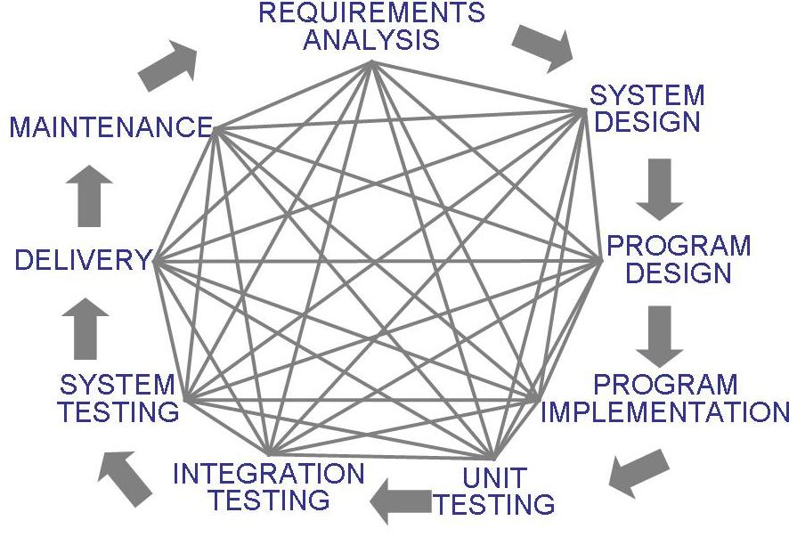
Waterfall Model (Contd.)
Uncontrolled Software Development Process
No Iterations in WF?
Loop: Problem Definition, Technical Design and Development, Integration, Operations and Maintenance
Notes:
Loop: Problem Definition, Technical Design and Development, Integration, Operations and Maintenance

Slide 16
Waterfall Model with Prototyping
A prototype is a partially developed product
Prototyping helps
developers assess alternative design strategies (design prototype)
users understand what the system will be like (user interface prototype)

Slide 17
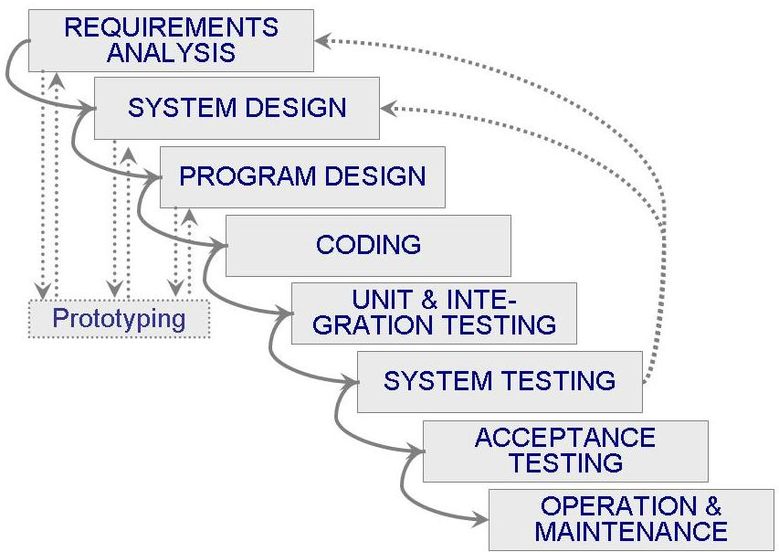
Waterfall Model with Prototyping

Slide 18
V Model
A variant of the waterfall model
Uses unit testing to verify procedural design
Uses integration testing to verify architectural (system) design
Uses acceptance testing to validate the requirements
If problems are found during verification and validation, the left side of the V can be re-executed before testing on the right side is re-enacted
Verification: Each function works correctly
Validation: All requirements have been implemented and each functionality can be traced back to a particular requirement

Slide 19
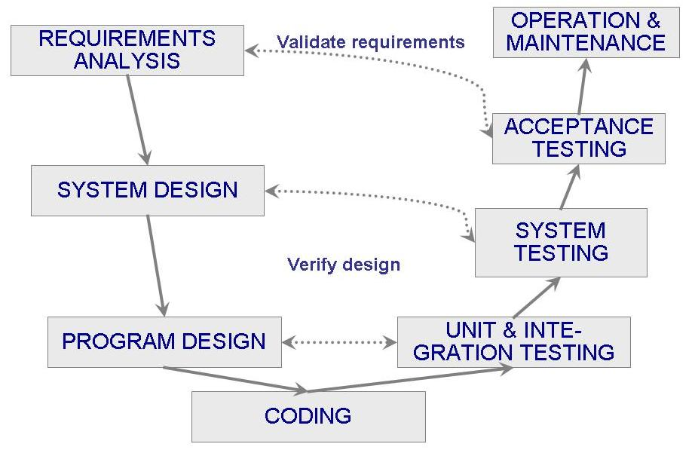
V Model (Contd.)

Slide 20
Phased Development
Cycle time
Time between when requirements document was written and when the system was delivered
Shorter cycle time
Decomposed system
System delivered in pieces
enables customers to have some functionality while the rest is being developed
Two systems functioning in parallel
the production system (release n): currently being used
the development system (release n+1): the next version

Slide 21
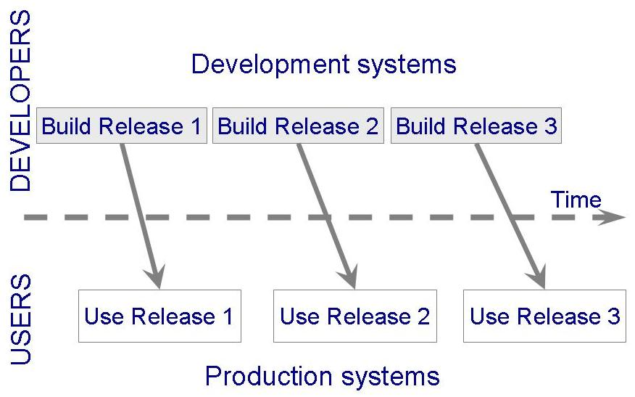
Phased Development (Contd.)

Slide 22
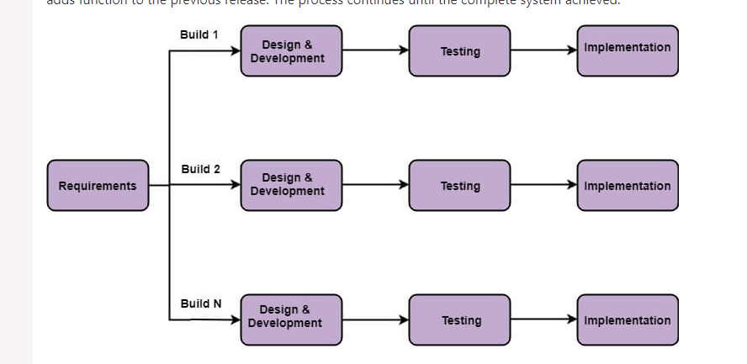
Incremental(Iterative) Model
Basic Requirements
Customer use the first release
Modification in the first release
Useful when staffing is unavailable

Slide 23
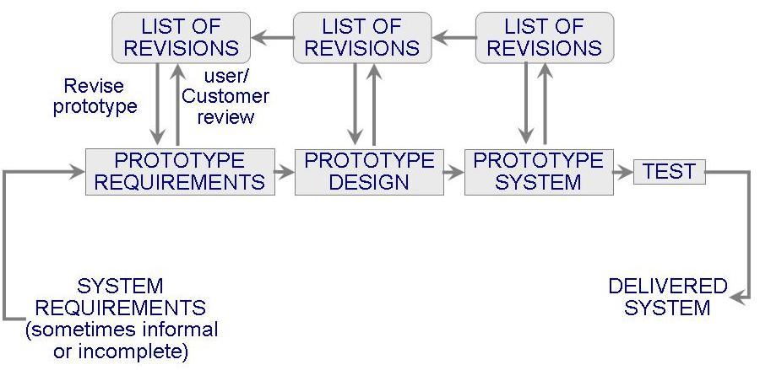
Prototyping Model
Allows repeated investigation of the requirements or design
Reduces risk and uncertainty in the development

Slide 24
Prototyping Model (Contd.)

Slide 25
Prototyping Model (Contd.)
RAPID (THROWAWAY) PROTOTYPING
Its name refers to the ease and speed with which a prototype can be modified to try different ideas with the user audience and incorporate their feedback.
EVOLUTIONARY PROTOTYPING
An evolutionary prototype differs from the traditional notion of a software prototype; an evolutionary prototype is a functional piece of software, not just a simulation.

Slide 26
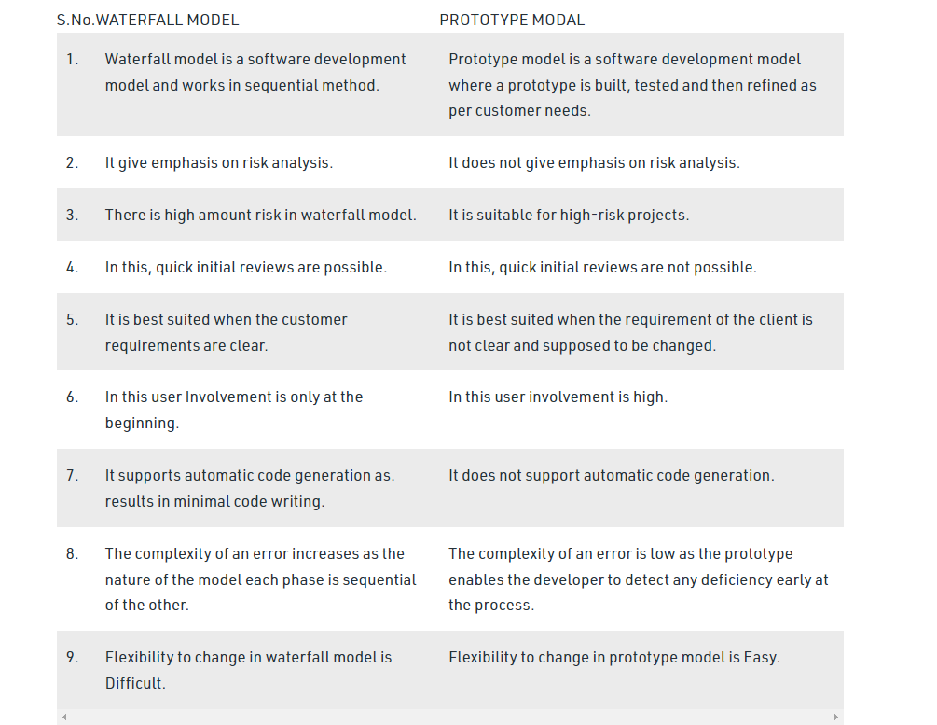
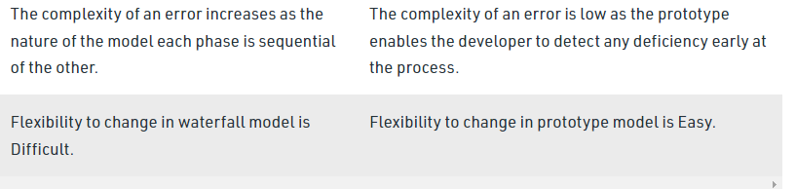
Waterfall vs Prototype

Slide 27
Spiral Model
Suggested by Boehm (1988)
Combines development activities with risk management to minimize and control risks
The model is presented as a spiral in which each iteration is represented by a circuit around four major activities
Plan
Determine goals, alternatives and constraints
Evaluate alternatives and risks
Develop and test

Slide 28
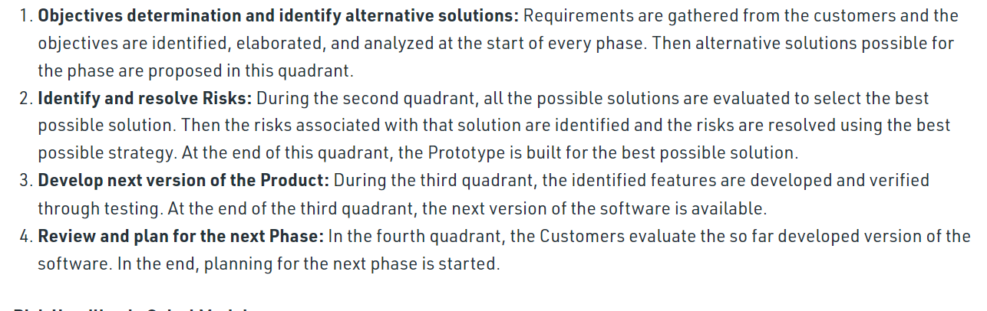
Spiral Model (Contd.)

Slide 29
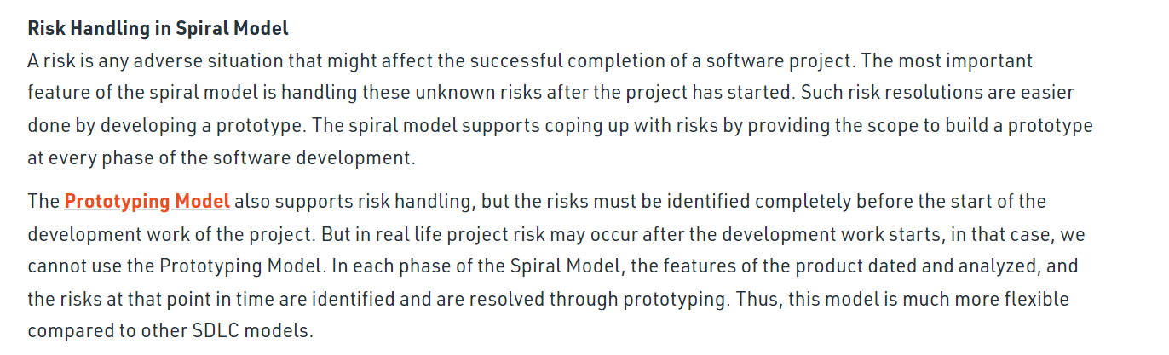
Spiral Model (Contd.)

Slide 30
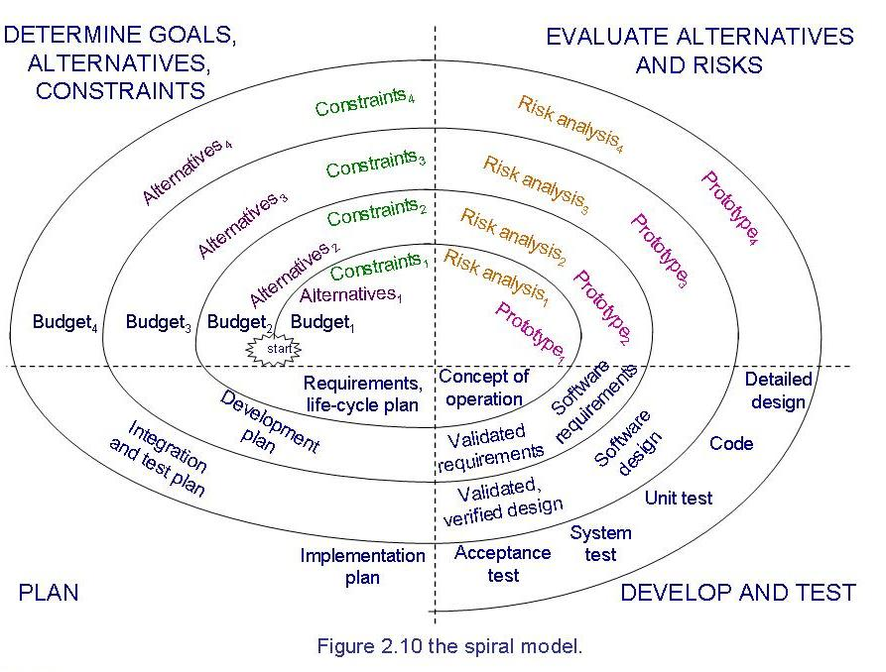
Spiral Model (Contd.)

Slide 31
Spiral Model (Contd.)
Difficult to convince customers to use evolutionary approach-

Slide 32
References
SE, Pressman
SE, Pfleeger
Acknowledgement
A few slides have been adapted from UCF slides for the SE course

